Slide 1
Anomaly Detection

Slide 2
One-Class Classifier
https://www.dlology.com/blog/how-to-do-novelty-detection-in-keras-with-generative-adversarial-network/
https://github.com/khalooei/ALOCC-CVPR2018

Slide 3
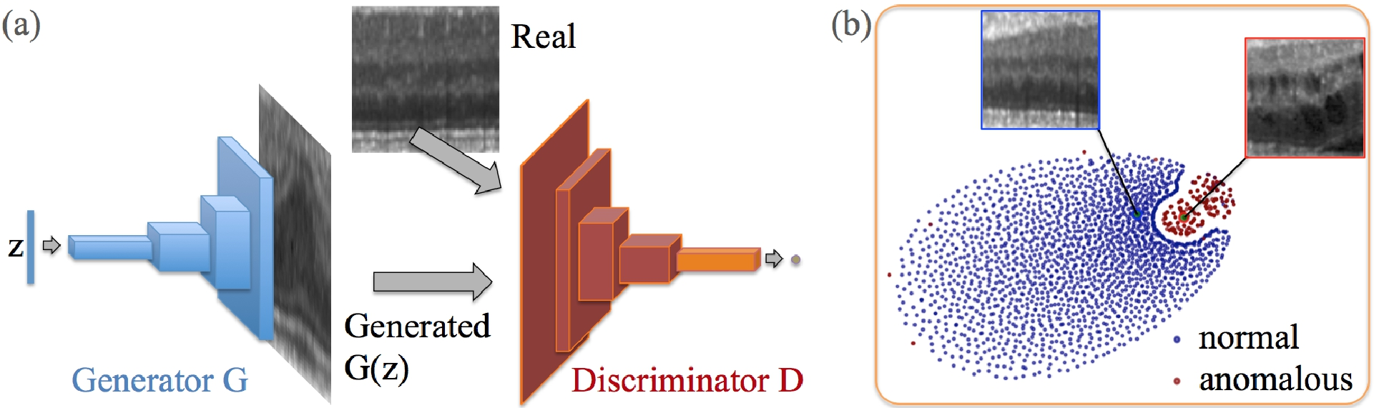
anoGAN for Unsupervised Anomaly Detection
(a) Deep convolutional generative adversarial network. (b) t-SNE embedding of normal (blue) and anomalous (red) images on the feature representation of the last convolution layer (orange in (a)) of the discriminator
Schlegl, Thomas, et al. "Unsupervised anomaly detection with generative adversarial networks to guide marker discovery." International Conference on Information Processing in Medical Imaging. Springer, Cham, 2017.
http://tongtianta.site/paper/4538

Slide 4




anoGAN for Unsupervised Anomaly Detection
residual loss:
Discrimination Loss:
Only the coeﬃcients of z are adapted via backpropagation. The trained parameters of the generator and discriminator are kept ﬁxed
Schlegl, Thomas, et al. "Unsupervised anomaly detection with generative adversarial networks to guide marker discovery." International Conference on Information Processing in Medical Imaging. Springer, Cham, 2017.

Slide 5
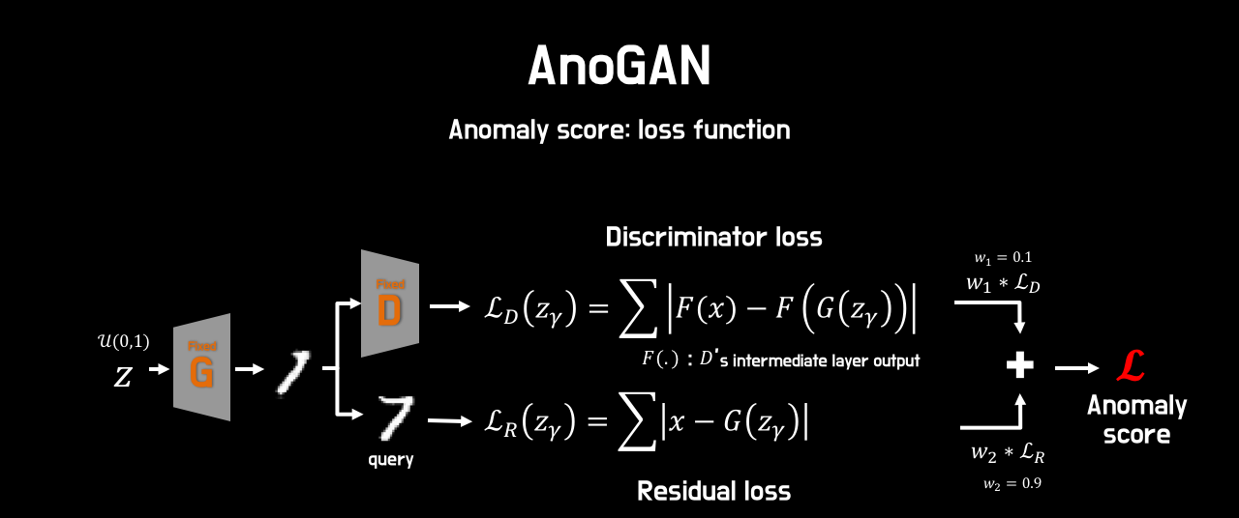
anoGAN for Unsupervised Anomaly Detection
Schlegl, Thomas, et al. "Unsupervised anomaly detection with generative adversarial networks to guide marker discovery." International Conference on Information Processing in Medical Imaging. Springer, Cham, 2017.

Slide 6
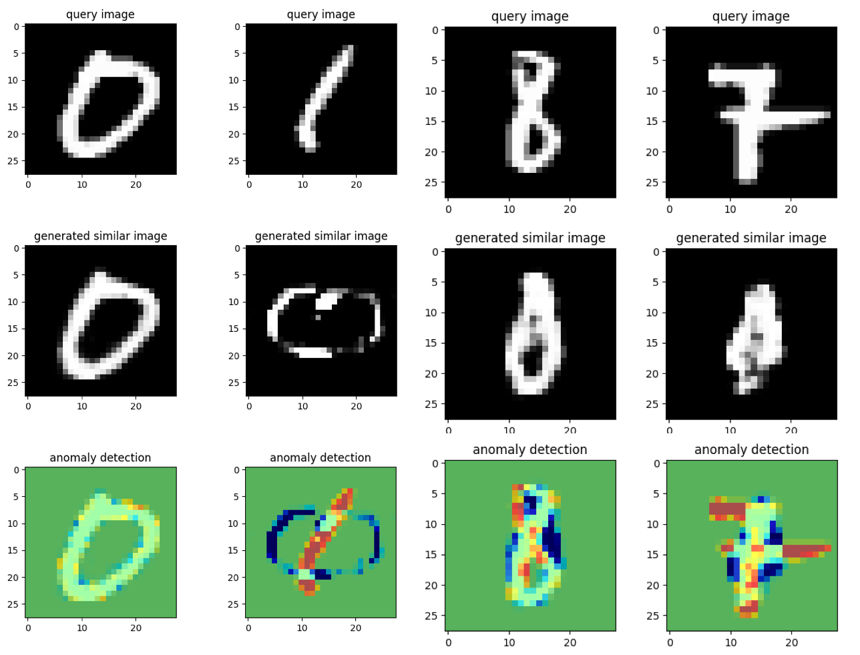
anoGAN for Unsupervised Anomaly Detection
https://github.com/oyxhust/wgan-gp-anomaly (wgan-gp)
https://github.com/fuchami/ANOGAN (DCGAN)
https://github.com/kosyoshida/simple-keras https://github.com/tkwoo/anogan-keras
AnoGAN(code, keras) : https://github.com/yjucho1/anoGAN AnoGAN(code, tf) : https://github.com/LeeDoYup/AnoGAN

Slide 7
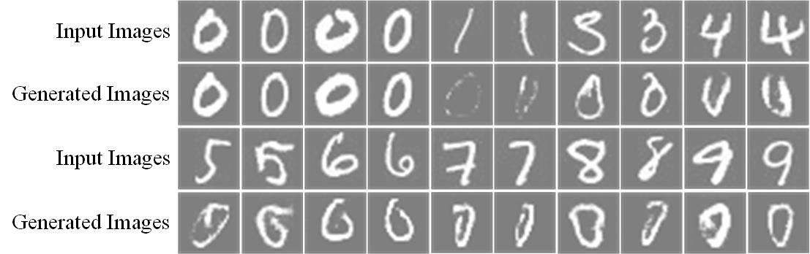
anoGAN for Unsupervised Anomaly Detection
https://github.com/oyxhust/wgan-gp-anomaly (wgan-gp)
https://github.com/fuchami/ANOGAN (DCGAN)
https://github.com/kosyoshida/simple-keras
Schlegl, Thomas, et al. "Unsupervised anomaly detection with generative adversarial networks to guide marker discovery." International Conference on Information Processing in Medical Imaging. Springer, Cham, 2017.

Slide 8
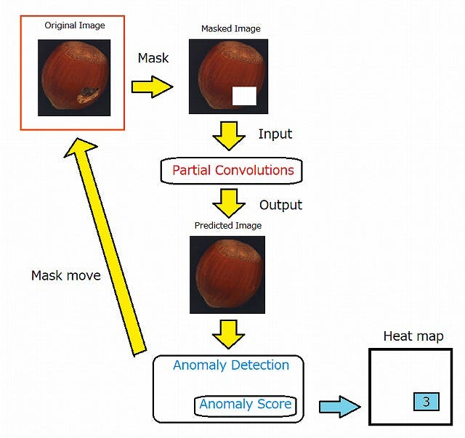
Ano-Unet
https://qiita.com/shinmura0/items/742adb4faefcfc8dd5cb

